Slide 1
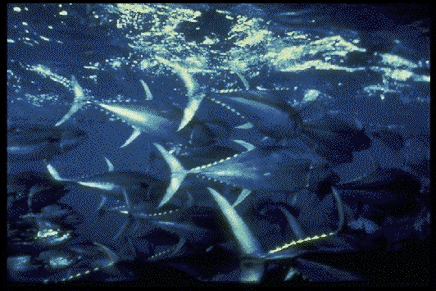
Americans, as well as people of other nations, eat a lot of tuna. Much of the canned tuna we eat is yellowfin tuna like those shown in this photograph.

Slide 2
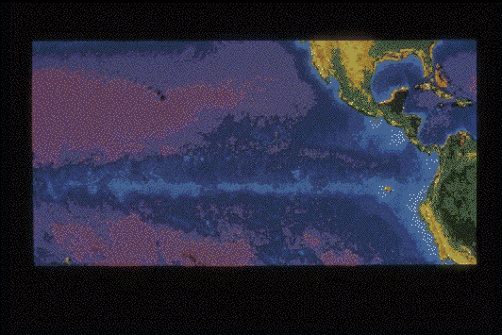
Yellowfin tuna are frequently found swimming near dolphins in the eastern Pacific Ocean from Baja California to Peru and westward to about Hawaii. Dolphins do not eat the tuna they swim with, nor vice-versa. Scientists are not sure why tunas and dolphins associate with one another. Many believe that they swim together because they eat similar foods. Scientists also believe that certain oceanographic features of the eastern Pacific Ocean also contribute to the tuna-dolphin association. This satellite photo shows the area of the fishery.

Slide 3
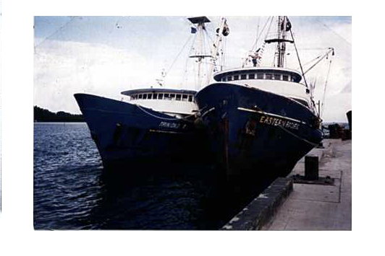
Over 100 tuna purse-seine vessels fish for tuna in the eastern Pacific Ocean. Most of these vessels are registered in Colombia, Ecuador, Mexico, Panama, the United States, Vanuatu, and Venezuela. Mexico has the largest fleet. These "tuna clippers" average a little over 200 feet in length. Each fishing trip lasts 40 to 60 days. During that time, the crew will catch and store about 1000 tons of tuna. The net they use to catch the tuna is called a "purse seine". A tuna purse seine net is almost a mile long. A mile is about as long as 12 city blocks. The net is 300-400 feet wide. If you were to stand on top of a 25-story tall building and hold the top of the net, the bottom of it would reach the ground. Fully spread out, the net could cover over 17 football fields!

Slide 4
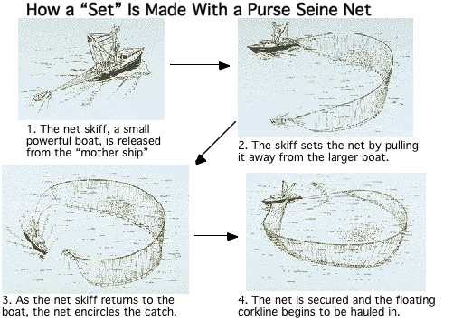
How does a purse seine net work? A small powerful boat called a “seine skiff” pulls one end of the long net away from the tuna boat. The other end of the net is fastened to the tuna boat. The net is towed around the dolphins and tuna.

Slide 5
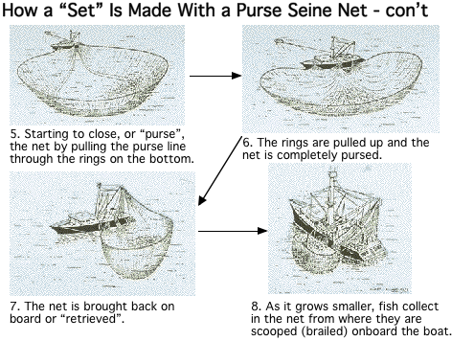
The two boats work together to complete the circle. The top of the net is kept in place by the cork line, a rope with floats attached to it. The bottom is held down by a heavy lead line. A third line, called the purse line runs through a series of rings on the lead line. The purse line is pulled in. It closes the bottom of the net the way a draw string closes a purse or bag. The tuna and the dolphins are caught.
One cycle of putting out(deploying) and taking in the net (retrieving) is called a "set". This diagram and the previous one show a tuna boat making a complete set.

Slide 6
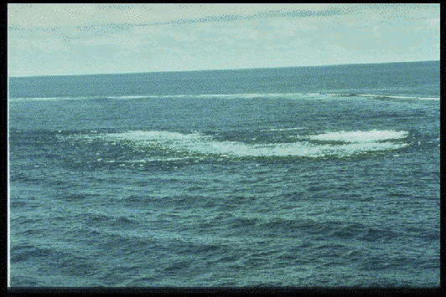
Tunas are caught by three methods. Some are caught as they swim with dolphins. Others are caught as they swim near floating trees and other objects. Still others are caught as free-swimming schools of tuna ("schoolfish").
Tuna boat crews find schools of tuna by looking for disturbances of the surface of the water caused by tuna feeding. This photo shows a set on a free-swimming school of tuna. This kind of set is called a "school set".

Slide 7
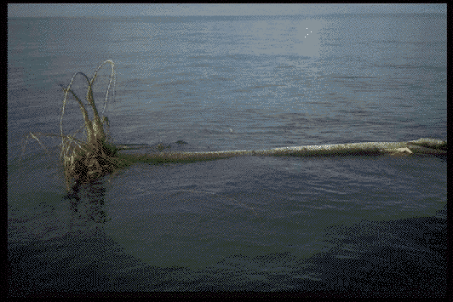
Schools of tuna are often found swimming near floating logs and other objects. They swim near the objects during the night, and leave when the sun rises. This photo shows a set on tunas associated with a floating log. This type of set is called a “log set”.

Slide 8
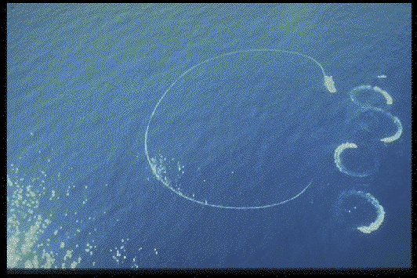
Tuna fishing came to the attention of many people because of the tuna caught swimming with dolphins. In this method, fishers detect the dolphins swimming at the surface, chase them with speedboats, and encircle them with the net. The tunas stay with the dolphins, so they end up encircled too. On an average set, about 400 to 500 dolphins are encircled along with 600 to 800 tuna. At this point fishers want to retain tunas and release dolphins. They have to work fast because dolphins breathe air and will drown if trapped in the net underwater. The photo shows a set on a dolphin herd. This type of set is called a “dolphin set”.

Slide 9
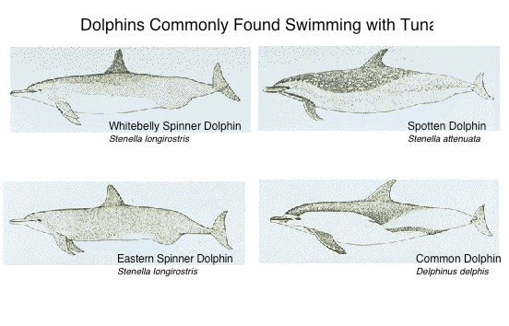
The tuna fleet makes about 8,000 to 10,000 net sets per year on tunas swimming with dolphins. Several species of dolphins are found swimming with tuna. Large yellowfin tunas swim in with the spotted dolphins, spinner dolphins, and common dolphins shown in this drawing.

Slide 10
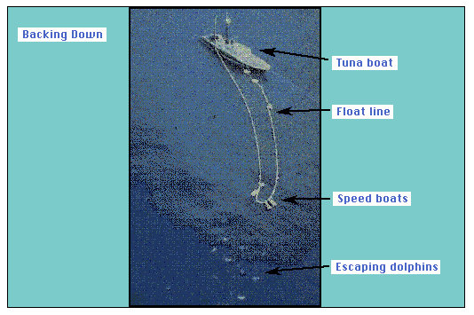
Tuna have not always been caught in nets. Before the late 1950's, most tunas were caught with a pole, using live bait. In the late 1950's, nylon nets, the hydraulic power block for net hauling, and better freezing systems changed the way tuna were caught. Fishers stopped using poles-and-lines and started using purse-seine nets. In these early years the accidental death of net-encircled dolphins was high. As many as several hundred thousand dolphins died each year in the early 1960's while fishers and scientists were developing techniques for releasing captured dolphins.
When they developed the backdown maneuver, the deaths were greatly reduced. Here's how the backdown maneuver works. After encircling the dolphins and fish and pursing the net (closing its submerged edge), the vessel goes in reverse. This causes the elongation of the net and the sinking of the corkline. (Recall that the corkline is a line of floats that keeps the upper edge of the net at the surface). The dolphins, which are closer to the surface than the tunas, now have an escape route. In a perfect set, all of the dolphins swim out. Currently 84% of the sets made on dolphins result in no dolphin deaths.
This photo shows the elongation of the net as a tuna clipper backs down to allow the corkline to sink.

Slide 11
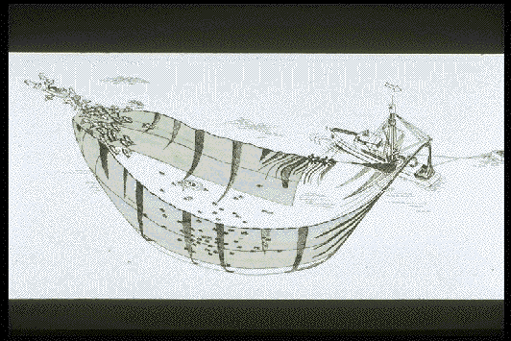
Small-mesh webbing was later installed in the dolphin-release area of the net. Called the Medina Panel, it helped keep dolphins from getting entangled in the net. With the panel, fewer dolphins drowned. The panel quickly became standard gear on all vessels.
The "backdown" procedure is still the primary release method used today.
In this diagram of a backdown, you can see the Medina Panel.

Slide 12
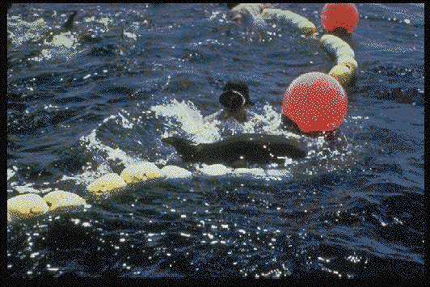
Once the pursed net is backed down, everyone on board springs into action. Crewpersons on rafts, divers, and swimmers like the one in this photo help rescue entangled dolphins.

Slide 13
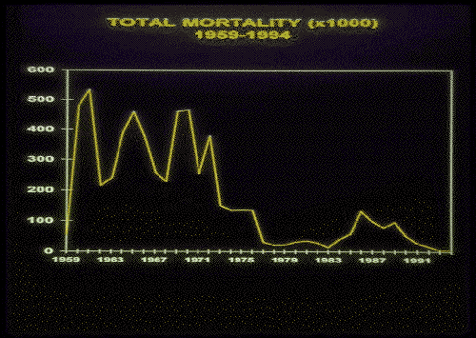
How successful has backing down been in reducing dolphin deaths? Look at the this line graph. It shows a history of dolphin deaths or mortality from 1959 to 1994. From 1959 to 1971, a great many dolphins died, perhaps as many as several hundred thousand each year. We say "perhaps" because the estimates are based on very limited data. (We have data for only 3 or 4 trips out of more than 4,000 made, and the trips on which sampling took place are not necessarily representative of the rest of the fishing trips.) During these years, the United States had by far the largest fleet fishing for tunas.
Notice that in 1972, the number of dolphins killed fell dramatically. What happened? In that year, the Marine Mammal Protection Act became US law. The law said that U.S. fishing boats had to use dolphin safety gear and procedures such as backing down to release dolphins, and implement an observer program. The idea was to reduce dolphin deaths to a low level. The law worked well.
In late 1970's, however, boats from many other countries began to fish for tuna. More effort by the fishers meant that more sets on dolphins occurred. Many of the skippers and crews were not familiar with the release of dolphins. Once again, many dolphins were killed. Considerably more data were collected in 1978-1985 than in early years, but these are also biased because not all countries participated in the observer program. Regardless, you can see that dolphin mortality reached a peak of about 133,000 dolphins in 1986. From 1986 on, all countries have passed dolphin protection laws similar to those of the United States. By looking at the graph, you can see that after 1986 the number of dolphin deaths went down. As observer coverage reached 100% in 1990, dolphin mortality continued to decline.

Slide 14
The data collected by the observers are used: a) to estimate mortality of dolphins, b) to detect changes in relative abundance of dolphin populations (using line-transect methods), and c) to identify factors that cause dolphin mortality. The tuna-dolphin program of the Inter-American Tropical Tuna Commission (IATTC) operates the observer program. The information helps the Commission train the fishers in the ways to deal with dolphin mortality factors. The Commission's activities include studies on dolphin behavior, experiments with gear and techniques, and ecological studies on the impacts of fishing. This diagram shows the structure and activities of the Inter-American Tropical Tuna Commission.

Slide 15
Virtually every trip of every vessel large enough to fish for dolphin associated tunas is accompanied by an observer. This table shows observer coverage in 1994, only one trip occurred without an observer. Observers have college degrees in biological science, and receive several weeks of training before going to sea. They help make sure that the fishers do all they can to avoid killing dolphins. With the exception of Mexico, all of the observers on the tuna boats are hired and trained by the IATTC. Half of the observers on Mexican boats are trained by the IATTC. The other half of the observers on the Mexican boats are hired and trained by the Mexican government.

Slide 16
The mortality of dolphins is a product of two factors: the level of effort (number of sets on dolphin-associated fish) and the average mortality per set. To reduce mortality, there are two options. The first is to reduce effort, which usually reduces the income of the fishers. The second is to reduce the average mortality per set by improving the technology, training the fishers, introducing regulations, etc.

Slide 17
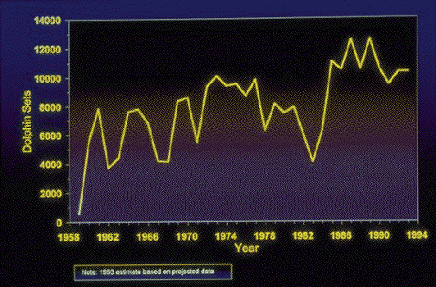
The level of effort reflected by the number of sets on dolphin-associated fish increased more or less steadily from 1959 to the mid- 1980's. It leveled off in 1986, and remained at around 10,000 to 12,000 sets until 1992.

Slide 18
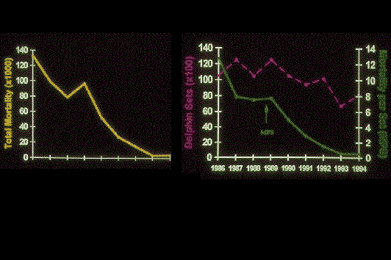
Improvements in fishing methods and gear greatly reduced the number of dolphins killed by tuna boats. People were pleased with the improvements. But they weren't completely happy. Even though the numbers were much smaller, some dolphins were still killed. Some people demanded that the tuna fleet completely stop fishing on tuna associated with dolphins. These demands led U.S. and many foreign tuna canneries to adopt a "dolphin safe" policy. This means that the canneries will not buy any tuna caught during a fishing trip in which dolphin sets were made. Let's look at what happened to dolphin deaths before and after the "dolphin safe" policy. The left panel shows dolphin mortality due to fishing during 1986-1994. Dolphin deaths dropped by 97% in that period. The right panel shows the two components of mortality: effort in pink and average mortality per set in green. The dolphin safe policy that started in 1990, the midpoint of the graphs.
What can we learn from these graphs? The messages here are: a) that in spite of the dolphin safe policy, fishers have continued fishing on dolphins, but b) that they have considerably improved their techniques and motivation, resulting in a dramatic decrease in dolphin deaths.
Several factors contributed to the decrease. Most of the reduction in dolphin mortality came from the fishers' efforts. Interestingly, a good part of that happened before the dolphin safe policy was instituted. The environmental community applied pressure that was translated into the Marine Mammal Protection Act. The act helped speed the improvements in this fishery. Acknowledgement of the problem by the fishing industry and nations with vessels participating in the fishery helped spur them to tackle the problem. The technical and scientific know-how existed to produce the change once the other elements were in place. Three strong communication links were also important in bringing about the decrease in dolphin deaths: scientists-fishers, environmentalists-industry, and nation-to-nation. Somehow all of these factors developed.

Slide 19
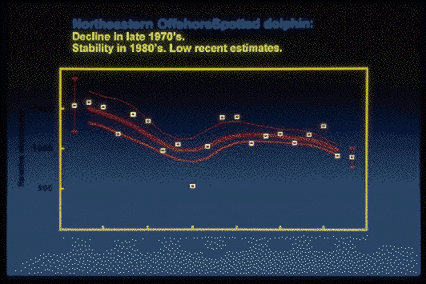
So, how are the dolphins doing? Using observer data, the Inter American Tropical Tuna Commission produces estimates of relative abundance of the various stocks of dolphins each year. The mortality levels in the 1960's caused major declines in the populations, but since then most of the stocks have been stable for at least 10 to 14 years. Contrary to popular belief, none of these dolphin species or stocks is threatened or endangered.

Slide 20
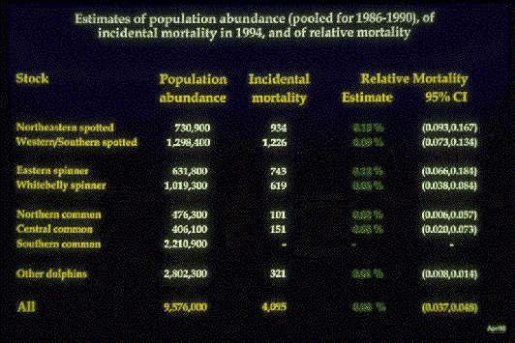
To put mortality in perspective, we need to look beyond the numbers of dolphins killed. Scientists look at something called "relative mortality". The "relative mortality" of a species is the mortality expressed as a percentage of the abundance of the population.
This chart shows the relative mortalities of the dolphin stocks affected by tuna fishing. The first column lists the stocks involved in the fishery. The second shows the estimates of abundance derived from National Marine Fisheries Service studies. The third column shows the mortality for each stock in 1994. The fourth shows the relative mortalities. The fifth shows a statistical interval around the mortality estimate. Notice that the relative mortalities are all below 0.13%, the total being 0.04%. So, less than 1% of the population dies as a result of dolphin sets. How does this affect the population? To answer this question, we must know how many dolphins are added to the populations each year. We can compare the relative mortalities to something called "net recruitment rates". The net recruitment rate is the ratio of the annual net increase to the total population. In dolphins net recruitment rates are estimated to be 2 to 4%. If we take the conservative estimate of recruitment rate of 2%, the mortality level is only 1/50th of the recruitment. This suggests that these populations are probably increasing at the current mortality level.
Estimates are never perfect, however, so scientists have to take their results with a grain of salt. What if we are overestimating abundances? What if we are underestimating mortality? What if the recruitment rates are less than we think they are?. Because of these concerns, we need to take into account our ignorance and uncertainty when making decisions on management and conservation. This is a called the Precautionary Principle. In our example, if the mortality levels were 50 times what we think they are, they would equal the net additions, and the populations would probably be stable. There is enough margin to feel confident of the basic conclusions.

Slide 21
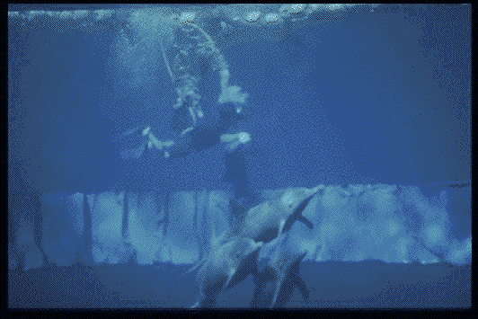
Efforts are being made to reduce the number of deaths even further. Scientists are working to improve gear and fishing methods. This underwater photo shows a new panel being tested on a net. The panel is designed to keep dolphins from becoming entangled in the net.

Slide 22
To help assure that the efforts to reduce dolphin mortality continue, in 1992 all countries fishing in the region signed the International Dolphin Conservation Program (IDCP). Here are the objectives to which the countries agreed. In simpler English, the program will set and enforce dolphin kill limits approaching zero, develop new ways to fish for tunas not in association with dolphins which protect the populations of yellowfin tuna.

Slide 23
The International Dolphin Conservation Program has several important features. First, it involves all of the fishing countries. Next, it requires 100% observer coverage. Another important feature is the International Review Panel. The panel has representatives of most of the nations with vessels participating in the fishery, plus two representatives of the fishing industry and two of the environmental community. This panel has access to the raw data from all observer programs, and makes recommendations concerning actions to be taken against fishers for their violations of the fishing regulations. The violations are then reported to the countries for further investigation and possible prosecution. Finally, the International Dolphin Conservation Program imposes total and individual vessel limits for dolphin deaths.

Slide 24
After the agreement was signed, the International Dolphin Conservation Program set decreasing annual limits of dolphin mortality for 1993-1999. Fishers have done better than expected and the limits have been modified twice. The lower limits are shown in the third column of this table.
How do the limits work? These overall limits are partitioned among vessels in the form of individual vessel limits. The individual boat limits are in the last column. Each boat has a share of the total quota. If a boat exceeds its individual limit it must stop fishing on dolphins for the rest of the year. In addition, the boat's share of the overall quota for the following year may be reduced by the amount that it exceeded its quota during the first year. The risk of losing fishing privileges has been a major factor in reducing mortality. Essentially, this approach emphasizes individual responsibility by using a "Darwinian" process to select the best operators and weed out the bad ones.

Slide 25
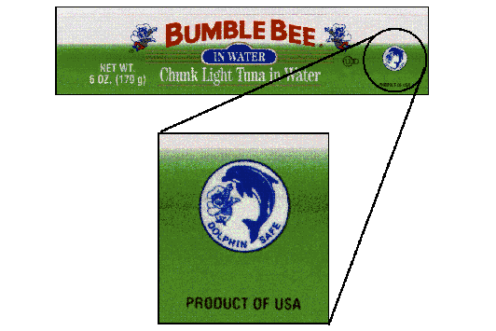
Once again, people were pleased with the reductions in dolphin mortality from tuna fishing. But not everyone was completely happy. Dolphins were still killed. Some people believe that zero is the only acceptable number for dolphin deaths. These people demand that the tuna fleet completely stop fishing on tuna associated with dolphins. They want U.S. and foreign tuna canneries to enforce a strict "dolphin safe" policy, refusing to buy any tuna caught during a fishing trip in which dolphin sets were made. They would like to see the "dolphin safe" emblem shown in the photo on all tuna to show that it was not caught by "fishing on dolphins". Stopping all fishing on dolphins would solve the problem of dolphin deaths.
Seems like a pretty neat solution. Unfortunately, things in nature are not always as simple as they seem at first. As you'll come to see, forcing the fleet to fish only on schoolfish and on tunas associated with floating objects has other consequences.

Slide 26
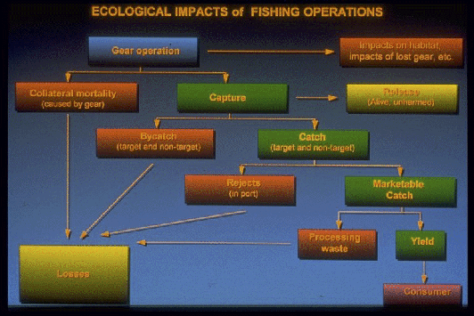
Before we look at school sets and log sets, we need to look at the ecological impacts of fisheries. All types of gear have an impact on the ecology; purse seines may catch dolphins, while lines of hooks, called longlines, that fish near the bottom rarely catch dolphins but do catch turtles and sharks. Scientists have diagramed some of these impacts from the time the gear is used until the fish reaches the consumer. Let's follow some of the steps along the way.
First, the gear may have some direct impact on the habitat; a bottom trawl net can disrupt animals and plants living on the bottom, or lost nets may continue to "ghost fish".
Next when the gear operates, two things can happen. The gear can catch and retain animals. These animals are called the "Capture". The gear can also catch animals which it does not retain. Often, fish or invertebrates will go through the mesh of a trawl net in pieces. These animals are called "Collateral Mortality". We can only estimate the collateral mortality from tests of gear. The collateral mortality becomes part of the "Losses" of the fishing operation.
"Capture" is what is physically retained in the net. Three things can happen to the animals in the "Capture". Some animals are released alive (Release), others are kept (Catch), while still others are returned to the sea dead (Bycatch). Bycatch becomes part of the "Losses" of the fishing operation.
The "Catch" is taken to a fish processor. There two things can happen. Some of the fish become "Marketable Catch" which will be further processed. Other fish which may be damaged or spoiled become "Rejects". Like the "Collateral Mortality" and the "Bycatch", the "Rejects" become part of the "Losses" of the fishing operations.
Not all of the "Marketable Catch" is edible. The edible parts become "Yield" and go on to the "Consumer". The inedible parts become "Processing Waste" and part of the "Losses" of the fishing operations.
The greatest potentials for harmful ecological impact in a fishing operation come from "Impacts on the Habitat", "Collateral Mortality", and "By Catch". In the tuna fishing industry the issue of bycatch is particularly important.

Slide 27
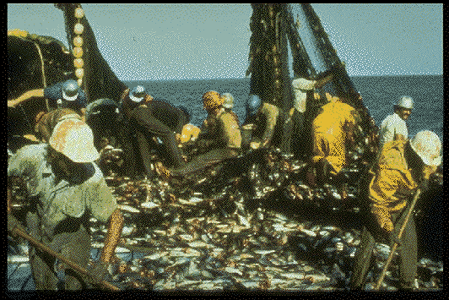
We already know that dolphins are part of the bycatch of "dolphin sets". "School set" and "log set" fishing catch few dolphins but result in large catches of fish other than tuna. Sharks, mahi-mahi, yellowtail, wahoo, billfish, rays, and other fish, including undersized tuna which are of no commercial value, are caught in great numbers. So are sea turtles.
Almost all of the bycatch fish from these sets die (the turtles don't usually die). The dead fish are returned to the sea. Some scientists think the large numbers of dead fish may harm the ocean's ecosystem. The small tunas being shoveled overboard in this photo were caught in a log set.
How do dolphin sets compare? Unlike log sets and school sets, there is almost no bycatch of other fish or sea turtles in sets on tunas associated with dolphins.

Slide 28
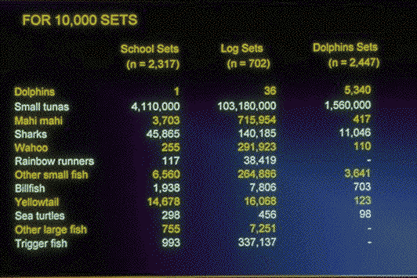
Each year, the tuna fleet makes about 10,000 sets. This table shows the bycatch if the 10,000 sets made, on average, on dolphins in recent years were switched to either log sets or school sets. The bycatches of dolphins are greater for dolphin sets than for sets on log-associated fish or fish in free-swimming schools, but the bycatches of other species are much lower in sets on dolphin-associated fish.
Clearly, "dolphin-safe" is not shark safe, billfish-safe, sea turtle-safe, etc.

Slide 29
So, just what are the tradeoffs? Looking at the bycatch data, we can compare the mortalities in log and dolphin sets, showing both sides of the scale. If we are to continue fishing for tuna, we'll have to choose one side or the other of the equation. Which side we choose depends on lots of things. Do we view dolphins as "morally" superior to the other species, or do we think that all animals deserve similar consideration? From the scientific point of view, it is difficult to choose because we don't know the effects that fishing has had, or might have, on most of the other species involved (one of the few exceptions being sea turtles). Thanks to the observer data, we have that information for dolphins, and we know there is no crisis for them. As a result, it appears that the cautious approach would be to avoid increasing the bycatches of species for which we don't have that information.
There is an interesting scientific problem here and an interesting moral one, as well. How many sharks is a dolphin worth, that is, how many sharks should be sacrificed to save one dolphin? Here worth means value to the ecosystem, not economic value. Which of the impacts is smaller, easier to compensate for, etc?. How can we decide which is the "best" way of fishing?
In short, there are no free lunches; all ways of fishing have costs. If we, as the tuna buying public doesn't know or doesn't care about all of the costs, the result could be ecologically-unsound decisions.

Slide 30
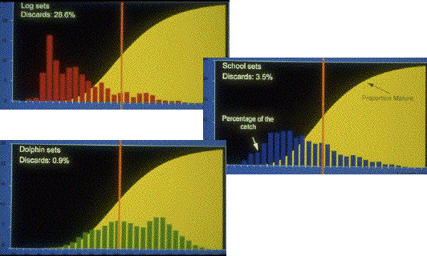
It's also worth comparing how well "dolphin sets", "log sets", and "school sets" use the tuna resource. A "good" fishery has three characteristics. First, it catches the fish near their optimum size to maximize the yield per fish. Second, it allows the individuals to reproduce before catching them. And, third, it wastes as little as possible.
For yellowfin tuna, the optimum size for harvesting is around 100-110 cm (slightly to the right of the vertical red line). These three histograms show the length-frequency distributions of the tunas caught on dolphins (in green), on logs (in red), and in free-swimming schools (in blue). A "length frequency distribution" shows the number or percentage of the different lengths of fish caught. The optimum size for harvesting is slightly to the right of the vertical red line.
Notice that the tuna caught in dolphin sets are close to the optimum size. On the other hand, most of the fish caught by school sets and log sets are considerably less than the optimum size. In terms of optimum size, the dolphin set fishery is superior.
How about in terms of allowing individuals to reproduce before catching them? Again, look at the histograms. The vertical red line shows the average length at sexual maturity. The yellow curve shows the proportions of fish that are mature at each size. Most of the fish caught on logs or in free-swimming schools are sexually immature. In terms of allowing reproduction, the dolphin set fishery is again superior.
How do the methods compare with regard to waste? The percentage of tunas discarded is shown in the upper left corner of histogram, below the title. Sets on logs result in discards of 20 to 30 percent, school sets 3 to 4 percent, and sets on dolphins less than 1 percent. So, from all three points of view of a "good" fishery, fishing on dolphins results in the best utilization of the tuna resource.

Slide 31
Given this information, what may be the effect of a tougher version of the "dolphin safe" tuna regulations? In order to avoid breaking the letter of the law, fishers can be expected to switch from dolphin sets to log sets and school sets. We've seen some of the impacts of such a shift. Since the tunas associated with floating objects and those in free-swimming schools are much smaller than those in associated with dolphins, elimination of fishing on tunas associated with dolphins would result in much lower catches of tunas. This is translated into the potential loss of jobs in the countries that fish participate in this fishery. It will also encourage other methods of fishing in other areas of the ocean.
It is important to remember that dolphin sets are not the only type of fishing that generates dolphin mortality. One way to compare the impact of the different fisheries is by comparing the mortality of dolphins per ton of tuna captured. In the eastern Pacific, one dolphin is killed for each 40 tons of tuna caught. In the Philippines, a government sponsored purse-seine fleet kills one dolphin for every 2.2 tons of tuna caught. A gillnet fishery in Sri Lanka results in one dolphin killed for every 4.4 tons of fish caught (most of the fish is tuna).
Here is the danger. Even though the kill rates per ton of tuna for these fisheries are higher than that of the purse-seine fishery of the eastern Pacific Ocean, the fish caught by the other fisheries can be labeled "dolphin-safe". Clearly, this tuna is less dolphin safe than that caught in the eastern Pacific in association with dolphins and which cannot be labeled dolphin safe.

Slide 32
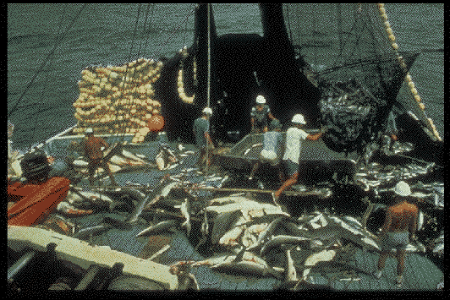
The sharks shown on the deck of this tuna boat are part of the bycatch of a log set. Clearly, there are negative side effects to log sets and school sets. Many scientists fear that the death of large numbers of so many different types of fish will upset the balance in the eastern tropical Pacific Ocean. They see the possibility that the food web will be disrupted. Such a change could affect the entire ecology of the area.
Our immediate goal should be to minimize dolphin deaths while conserving other species of the ecosystem as well. What about long range goals? The "normal" view of the tuna-dolphin problem is Flipper versus Big Business/Greedy Fishermen. In fact, many other species are affected by our decisions. So are many thousands of cannery workers and other "regular" people. Nobody benefits by the incidental kill of dolphins. If a stock of dolphins was in danger of extinction, drastic action to prevent that could be justified. What about in this situation, where the populations are not in danger of extinction? In this case, if the dolphin mortality is not sustainable, prompt action to reduce it to sustainable levels would be called for. If the present mortality is sustainable, however, what are the costs of reducing the mortality even further?
If reduction of the mortality from 4,000 to 40 costs 10,000 jobs, are we prepared to pay that price? Would your answer differ if you held one of the 10,000 jobs? Would your answer differ if you lived in Mexico or Ecuador? It seems that we're left with some hard choices. Using current fishing methods, dolphin sets cause the death of 3,000 or 4,000 dolphins each year. While this is a considerable number of dolphins, it is not a large percentage of the total population of 9,500,000 dolphins. Log sets and school sets, on the other hand, cause the death of 2,000,000 to 4,000,000 (50,000,000 to 200,000,000 pounds of) other marine animals.
Nobody wants to kill dolphins. We can easily see that "dolphin-safe" is not shark safe, billfish-safe, sea turtle-safe, etc. We've seen that all ways of fishing have costs. If we don't know or don't care about the other costs, we may make harmful decisions. So, each of us is faced with the question, "Do you think the trade of 2,000,000 to 4,000,000 other marine animals for 4,000 dolphins is a good one?“ The lessons and activities which you will be doing will help you to answer this question for yourself and to see that each ocean animal and plant has a special role to play. As we learn about their roles, we will do well to apply that knowledge to complex problems. From the tuna/dolphin controversy we can see simple solutions to complex problems sometimes become problems of their own.

