Slide 1
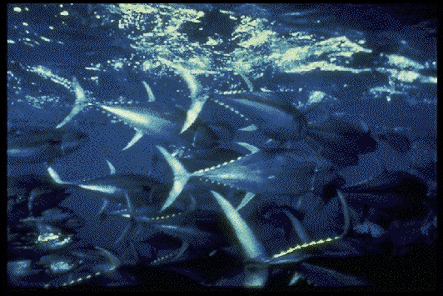
Americans, as well as people of other nations, eat a lot of tuna. Much of the canned tuna we eat is yellowfin tuna like those shown in this photograph.

Slide 2
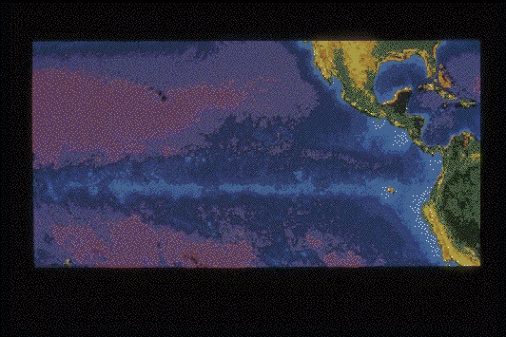
Yellowfin tuna are frequently found swimming near dolphins in the eastern Pacific Ocean. Dolphins do not eat the tuna they swim with, nor vice-versa. Scientists are not sure why tunas and dolphins associate with one another. Many believe that they swim together because they eat similar foods. This satellite photo shows the area of the fishery.

Slide 3
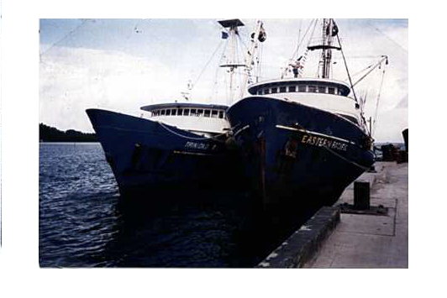
Over 100 tuna purse-seine vessels fish for tuna in the eastern Pacific Ocean. These “tuna clippers” average a little over 200 feet in length. Each fishing trip lasts 40 to 60 days. During that time, the crew will catch and store about 1000 tons of tuna. The net they use to catch the tuna is called a “purse seine”. A tuna purse seine net is almost a mile long. A mile is about as long as 12 city blocks. The net is 300-400 feet wide. If you were to stand on top of a 25-story tall building and hold the top of the net, the bottom of it would reach the ground. Fully spread out, the net could cover over 17 football fields!

Slide 4
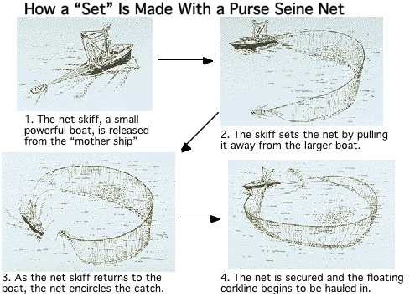
How does a purse seine net work? A small powerful boat called a “seine skiff” pulls one end of the long net away from the tuna boat. The other end of the net is fastened to the tuna boat. The net is towed around the dolphins and tuna.

Slide 5
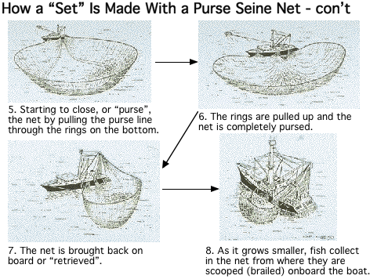
The two boats work together to complete the circle. The top of the net is kept in place by the cork line, a rope with floats attached to it. The bottom is held down by a heavy lead line. A third line, called the purse line runs through a series of rings on the lead line. The purse line is pulled in. It closes the bottom of the net the way a draw string closes a purse or bag. The tuna and the dolphins are caught.
One cycle of putting out and taking in the net is called a “set”. This diagram and the previous one show a tuna boat making a complete set.

Slide 6
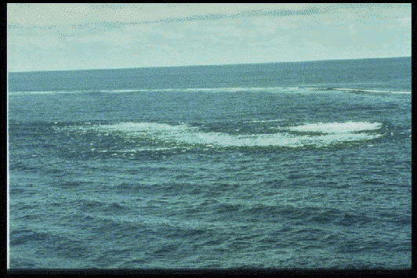
Tunas are caught by three methods. Some are caught as they swim with dolphins. Others are caught as they swim near floating trees and other objects. Still others are caught as free-swimming schools of tuna (“schoolfish”).
Tuna boat crews find schools of tuna by looking for disturbances of the surface of the water caused by tuna feeding. This photo shows a set on a free-swimming school of tuna. This kind of set is called a “school set”.

Slide 7
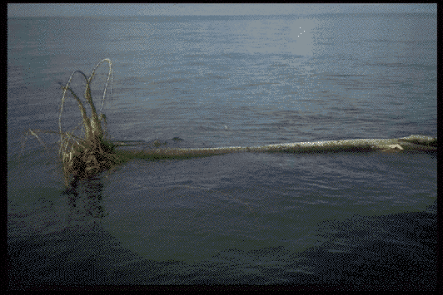
Schools of tuna are often found swimming near floating logs and other objects. They swim near the objects during the night, and leave when the sun rises. This photo shows a set on tunas associated with a floating log. This type of set is called a “log set”.

Slide 8
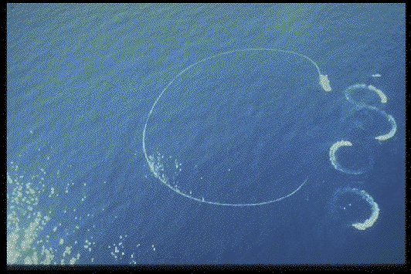
Tuna fishing came to the attention of many people because of the tuna caught swimming with dolphins. In this method, fishers detect the dolphins swimming at the surface, chase them with speedboats, and encircle them with the net. The tunas stay with the dolphins, so they end up encircled too. On an average set, about 400 to 500 dolphins are encircled along with 600 to 800 tuna. At this point fishers want to retain tunas and release dolphins. They have to work fast because dolphins breathe air and will drown if trapped in the net underwater. The photo shows a set on a dolphin herd. This type of set is called a “dolphin set”.

Slide 9
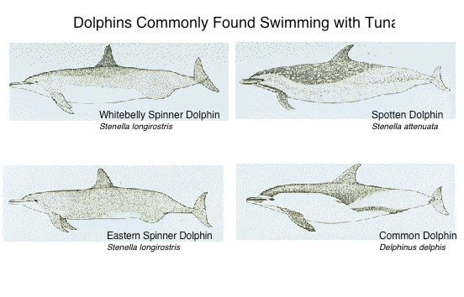
The tuna fleet makes about 8,000 to 10,000 net sets per year on tunas swimming with dolphins. Several species of dolphins are found swimming with tuna. Large yellowfin tunas swim in with the spotted dolphins, spinner dolphins, and common dolphins shown in this drawing.

Slide 10
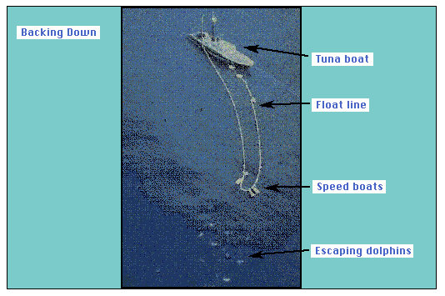
Tuna have not always been caught in nets. Before the late 1950's, most tunas were caught with a pole, using live bait. In the late 1950's, nylon nets, the hydraulic power block for net hauling, and better freezing systems changed the way tuna were caught. Fishers stopped using poles-and-lines and started using purse-seine nets. In these early years the accidental death of net-encircled dolphins was high. As many as several hundred thousand dolphins died each year in the early 1960's while fishers and scientists were developing techniques for releasing captured dolphins.
When they developed the backdown maneuver, the deaths were greatly reduced. Here's how the backdown maneuver works. After encircling the dolphins and fish and pursing the net (closing its submerged edge), the vessel goes in reverse. This causes the elongation of the net and the sinking of the corkline. (Recall that the corkline is a line of floats that keeps the upper edge of the net at the surface). The dolphins, which are closer to the surface than the tunas, now have an escape route. In a perfect set, all of the dolphins swim out. Currently 84% of the sets made on dolphins result in no dolphin deaths.
This photo shows the elongation of the net as a tuna clipper backs down to allow the corkline to sink.

Slide 11
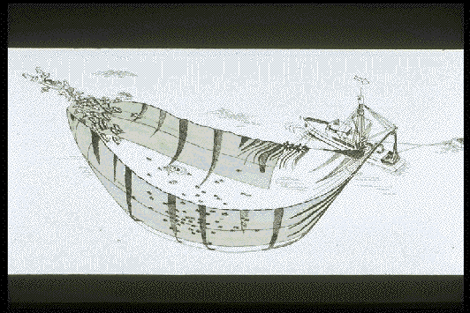
Small-mesh webbing was later installed in the dolphin-release area of the net. Called the Medina Panel, it helped keep dolphins from getting entangled in the net. With the panel, fewer dolphins drowned. The panel quickly became standard gear on all vessels.
The “backdown” procedure is still the primary release method used today.
In this diagram of a backdown, you can see the Medina Panel.

Slide 12
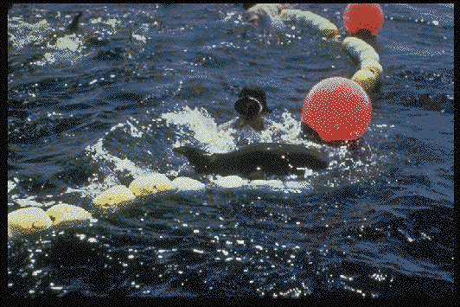
Once the pursed net is backed down, everyone on board springs into action. Crewpersons on rafts, divers, and swimmers like the one in this photo help rescue entangled dolphins.

Slide 13
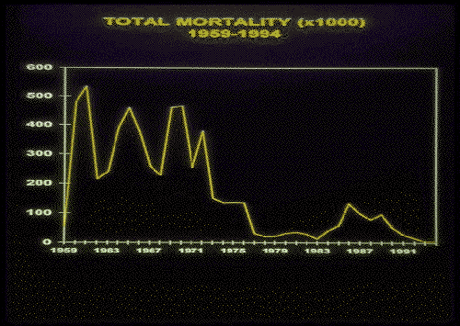
How successful has backing down been in reducing dolphin deaths? Look at the this line graph. It shows a history of dolphin deaths or mortality from 1959 to 1994. From 1959 to 1971, a great many dolphins died, perhaps as many as several hundred thousand each year. During these years, the United States had by far the largest fleet fishing for tunas.
Notice that in 1972, the number of dolphins killed fell dramatically. What happened? In that year, the Marine Mammal Protection Act became US law. The law said that U.S. fishing boats had to use dolphin safety gear and procedures such as backing down. The idea was to reduce dolphin deaths to a low level. The law worked well.
In late 1970's, however, boats from many other countries began to fish for tuna. More sets on dolphins occurred. Many of the skippers and crews were not familiar with the release of dolphins. Once again, many dolphins were killed. You can see that dolphin deaths reached a peak of about 133,000 dolphins in 1986. From 1986 on, all countries have passed dolphin protection laws similar to those of the United States. By looking at the graph, you can see that after 1986 the number of dolphin deaths went down.

Slide 14
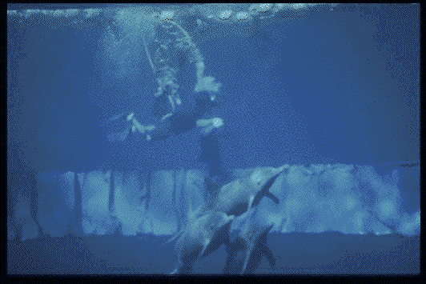
Efforts are being made to reduce the number of deaths even further. Every trip of every boat large enough to fish for dolphin associated tunas carries an “observer”. Observers have college degrees in biological science. They make sure that the fishers do all they can to avoid killing dolphins.
At the same time, scientists are working to improve gear and fishing methods. This underwater photo shows a new panel being tested on a net. The panel is designed to keep dolphins from becoming entangled in the net.

Slide 15
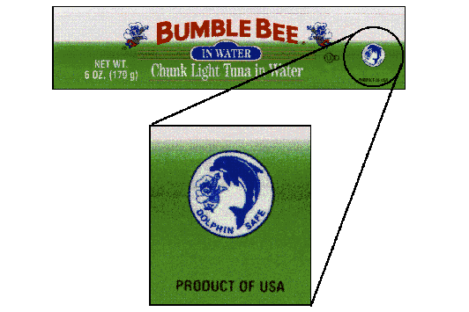
People were pleased with the improvements in fishing methods. But they weren't completely happy. Even though the numbers were much smaller, some dolphins were still killed. Some people demanded that the tuna fleet completely stop fishing on tuna associated with dolphins. These demands led U.S. and many foreign tuna canneries to adopt a “dolphin safe” policy. This means that the canneries will not buy any tuna caught during a fishing trip in which dolphin sets were made.
The “dolphin safe” emblem shown in the photo shows that this tuna was not caught by “fishing on dolphins”. So, stopping all fishing on dolphins would solve the problem of dolphin deaths. Seems like a pretty neat solution. Unfortunately, things in nature are not always as simple as they seem at first. As you'll come to see, forcing the fleet to fish only on schoolfish and on tunas associated with floating objects has other consequences.

Slide 16
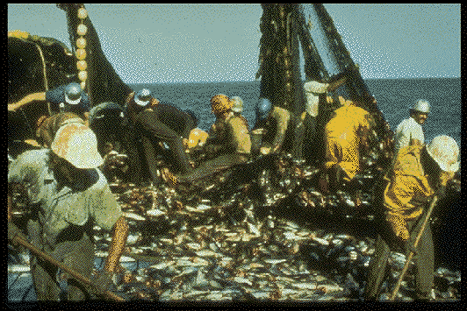
“School set” and “log set” fishing result in large catches of fish other than tuna. Sharks, mahi-mahi, yellowtail, wahoo, billfish, rays, and other fish, including undersized tuna which are of no commercial value, are caught in great numbers. So are sea turtles. These fish and turtles are called “bycatch”.
Almost all of the bycatch fish die (the turtles don't usually die). The dead fish are returned to the sea. Some scientists think the large numbers of dead fish may harm the ocean's ecosystem. The small tunas being shoveled overboard in this photo were caught in a log set.

Slide 17
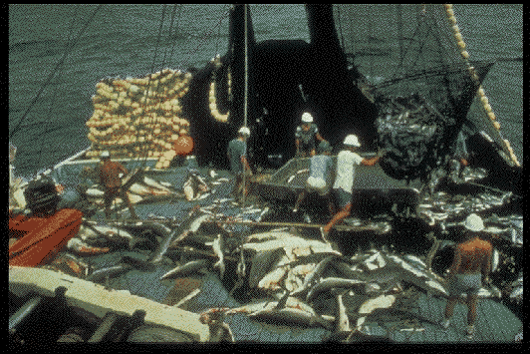
The sharks shown on the deck of this tuna boat are part of the bycatch of a different log set. Clearly, log sets and school sets pose problems. Many scientists fear that the death of so many fish will disrupt the food web in the eastern Pacific Ocean. Such a change could affect the entire ecology of the area.
But doesn't all tuna fishing have ecological impacts? How do dolphin sets compare? Unlike log sets and school sets, there is almost no bycatch of other fish or sea turtles in sets on tunas associated with dolphins. Our immediate goal should be to minimize dolphin deaths while conserving other species of the ecosystem as well. What about long range goals?
It seems that we're left with some hard choices. Using current fishing methods, dolphin sets cause the death of 3,000 or 4,000 dolphins each year. While this is a considerable number of dolphins, it is not a large percentage of the total population of 9,500,000 dolphins. Log sets and school sets, on the other hand, cause the death of 2,000,000 to 4,000,000 other marine animals.
Nobody wants to kill dolphins. We can easily see that “Dolphin-safe” is not shark safe, billfish-safe, sea turtle-safe, etc. All ways of fishing have costs. If we don't know or don't care about the other costs, we may make harmful decisions.
So, each of us is faced with the question, “Do you think the trade of 2,000,000 to 4,000,000 other marine animals for 4,000 dolphins is a good one?”
The lessons and activities which you will be doing will help you to answer this question for yourself and to see that each ocean animal and plant has a special role to play. As we learn about their roles, we will do well to apply that knowledge to complex problems. From the tuna/dolphin controversy we can see simple solutions to complex problems sometimes become problems of their own.

